Slide 1
OFDM PAPR Reduction through PTS technique

Slide 2
Table of contents
The PAPR problem in OFDM
Theory
PAPR reduction techniques
The PTS technique
PTS simulations
Incorporation into the OFDM modem

Slide 3
The PAPR problem in OFDM

Slide 4
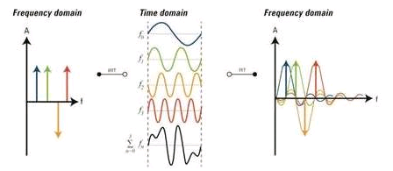
Background- OFDM
The principle: transmission of a signal that is a linear combination of an orthogonal basis
The symbols are the linear combination’s coefficients and are statistically independent:

Slide 5
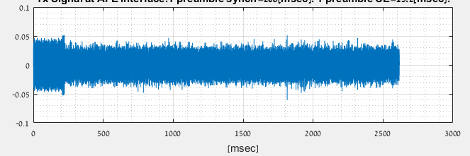
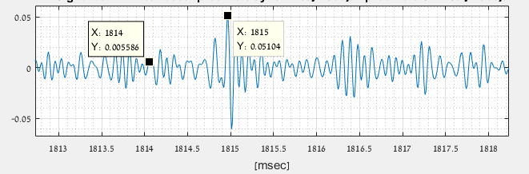
Background- OFDM
Time domain signal:
Typical shape

Slide 6
Motivation: PA linearity

Slide 7
Theory

Slide 8
PAPR definition

Slide 9
PAPR distribution (CCDF) [1]
Central limit theorem:
Magnitude is Rayleigh distributed:
Hence;

Slide 10
PAPR distribution (CCDF)
Probability of at least 1 sample of time domain signal to cross a certain power level:
if we define , then;

Slide 11
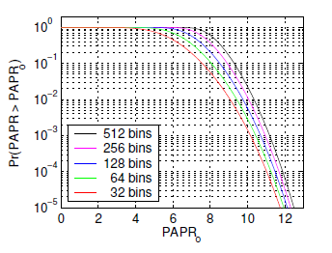
PAPR distribution (CCDF) [1]
Theoretical curves

Slide 12
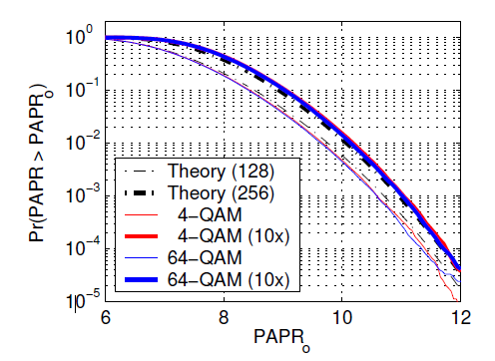
PAPR distribution –Interpolation [1]
Analog signal can be modeled by an interpolated digital signal
Interpolated digital signal has no longer uncorrelated samples
An interpolated N-samples symbol has effectively the non-interpolated PAPR of a 2N-samples symbol

Slide 13
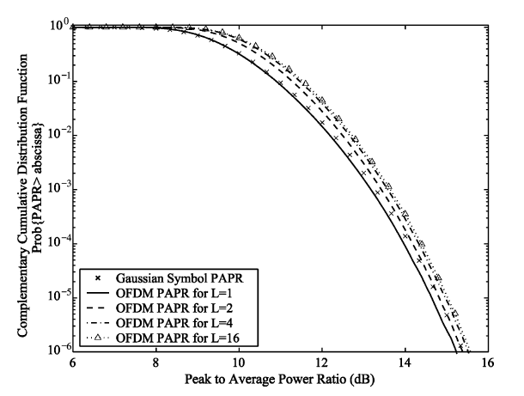
PAPR distribution -Interpolation
The effect of increasing the interpolation factor attains a limit
Typically, a value of L=4 is sufficient

Slide 14
PAPR dependencies
Modulation
Number of carriers
Sampling rate?
Interpolation to approach the analog signal

Slide 15
PAPR reduction techniques

Slide 16
Criteria
PAPR reduction
BER performance
Average power conservation
Data Rate
Spectral spillage
Complexity

Slide 17
Techniques comparison
Technique | PAPR Reduction | BER performance | Average power Conservation | Data Rate Loss | Spectral Spillage | Complexity
Clipping | 3dB | Low | Yes | None | Yes | Low
Coding | 3dB | Medium | Yes | Medium | No | Low
Companding | 6dB | Medium | No | None | Yes | Low
Tone Reservation | 3dB | Medium | No | High | No | High
PTS/SLM | 3dB | High | Yes | Medium | No | High

Slide 18
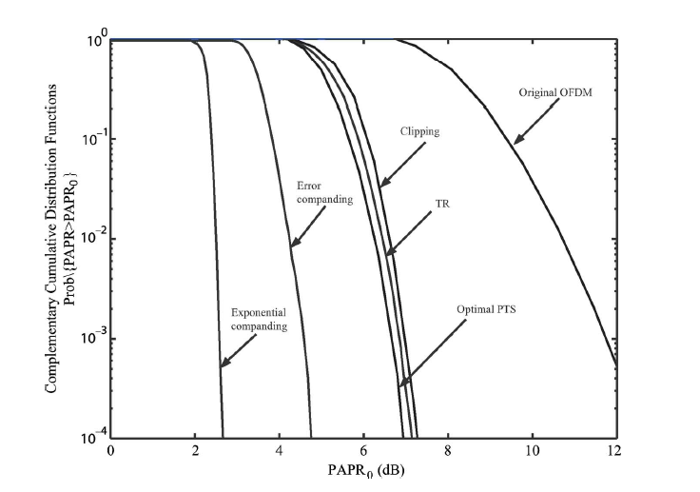
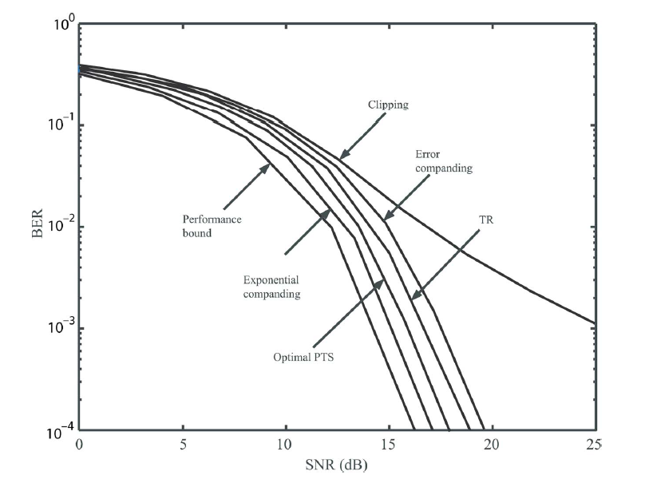
Techniques comparison
Most literature ([4], [5] ,[6] and others) claims the SLM/PTS technique
tradeoffs best the different performance criteria

Slide 19
The Partial Transmit Sequence (PTS) Technique

Slide 20
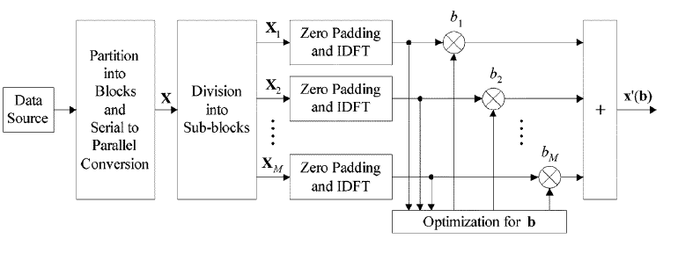
PTS- Block Diagram

Slide 21
Algorithm steps
Division of the N-long OFDM symbol into M sub-blocks:
Contiguous
Polyphase
Zero padding of each of the sub-blocks to length of N
IDFT over each of the sub-blocks
Calculation of optimum PTS coefficients vector:
Iterative flipping
Reduced complexity
Multiplication of the sub-blocks by the PTS coefficients
Summation of the sub-blocks

Slide 22
The improvement Metrics
PAPR at 1e-3

Slide 23
Iterative flipping

Slide 24
Reduced complexity

Slide 25
The PTS technique

Slide 26
PTS simulations

Slide 27
Scrambling method
Contiguous
scrambled

Slide 28
Reduced complexity Vs. Iterative flipping

Slide 29
Incorporation into the OFDM modem

Slide 30
References
Circuit-Aware System Design Techniques for Wireless Communication, by Everest Wang Huang
OFDM for wireless communication systems, Prasad
An Overview: Peak-to-Average Power Ratio Reduction Techniques for OFDM Signals, Jiang& Wu
PAPR Reduction of OFDM Signals Using a Reduced Complexity PTS Technique, Hee Han & Hong Lee
peak to average power ration in OFDM, Chapter 3. Shodhganga
PAPR Reduction Techniques for OFDM Systems, P.Kalaivani, ,S.R.Balasubramanian,

